Slide 1
Design and Development of Applications
for Mobile Devices
Camera and 3rd Party Libraries
Semester 1, 2019

Slide 2
Using the camera
Coding options
Launch an intent that starts the on-board camera app
Write your own low-level code to control the camera device
Development options
Using the emulator
Using a real device

Slide 3
Camera via intent
Setup
Create a unique file name and path for your image
Create the appropriate file
Create an intent to launch the camera app and assign your file to the intent
Launch
Launch the intent with startActivityForResult(). This transfers control to the camera app
Callback
Write an onActivityResult() handler to run after control is returned to your app

Slide 4
Setup
Use internal app storage
Call openFileOutput()
developer.android.com/training/basics/data-storage/files.html
Use the system image directory
Environment.getExternalStoragePublicDirectory(Environment.DIRECTORY_PICTURES);
Include WRITE_EXTERNAL_STORAGE permission in AndroidManifest.xml

Slide 5
Setup
Get the image root path
Create a subdirectory for your app
Generate a timestamp
Build the complete path name
Create the file in the subdirectory

Slide 6
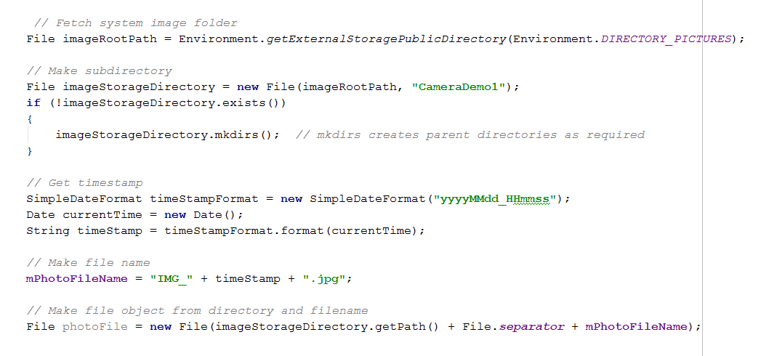
Setup

Slide 7
Launch
Generate a URI from your file object
Create an implicit intent with input argument ACTION_IMAGE_CAPTURE
Use putExtra() to attach the URI to the intent. Use the MediaStore.EXTRA_OUTPUT system key
Call startActivityForResult()

Slide 8
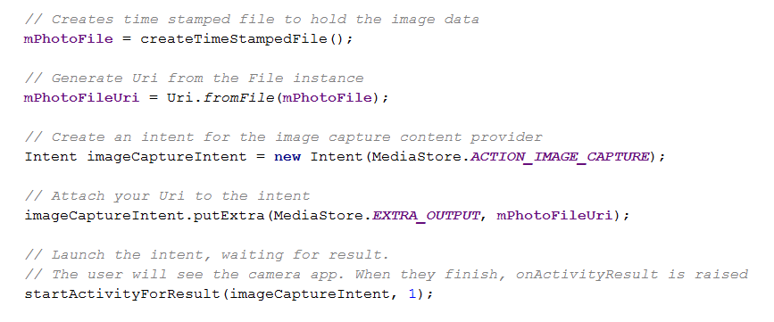
Launch

Slide 9
Callback
OnActivityResult() is raised after the user takes a picture and saves it
In your onActivityResult() handler, you can fetch the image from memory and use it

Slide 10
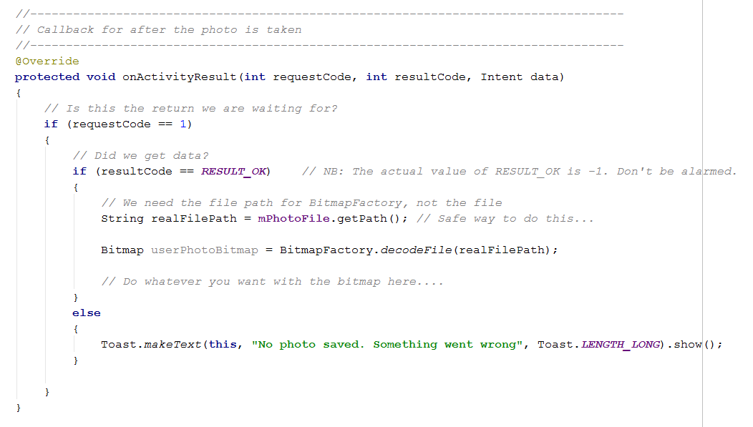
Callback

Slide 11
Technical note
If the user rotates the phone while using the camera, your app will crash. This is caused by the tear-down cycle
To prevent the tear-down on rotation, add this attribute to your activity in the manifest
android:configChanges="orientation|screenSize"

Slide 12
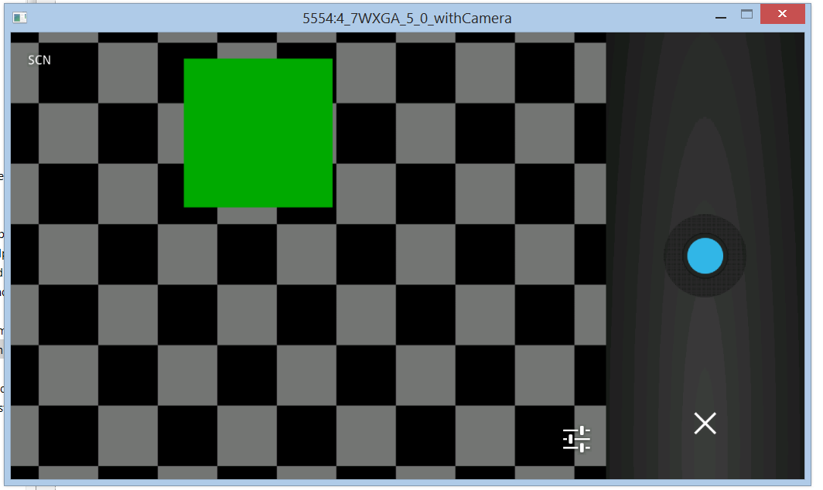
Emulator camera
Notes:
Check your emulator has a camera
If it has a camera, it will launch an emulated app, as shown
The green square currently will bounce of the screen and change to red periodically

Slide 13
Using a real phone
Open the Developer Options menu item
Enabled Developer Option and USB Debugging
Connect your phone to the computer via USB
Install drivers if you must
Your phone version will appear in the AVD run list

Slide 14
Practical – Photo Mosaic
Please do this practical using API 21
Set the minSdkVersion and targetSdkVersion to 21
Build an application that lets the user take a photo, which is then displayed as a 4-tile mosaic
Test your application both with the emulator and with a real Android device

Slide 15
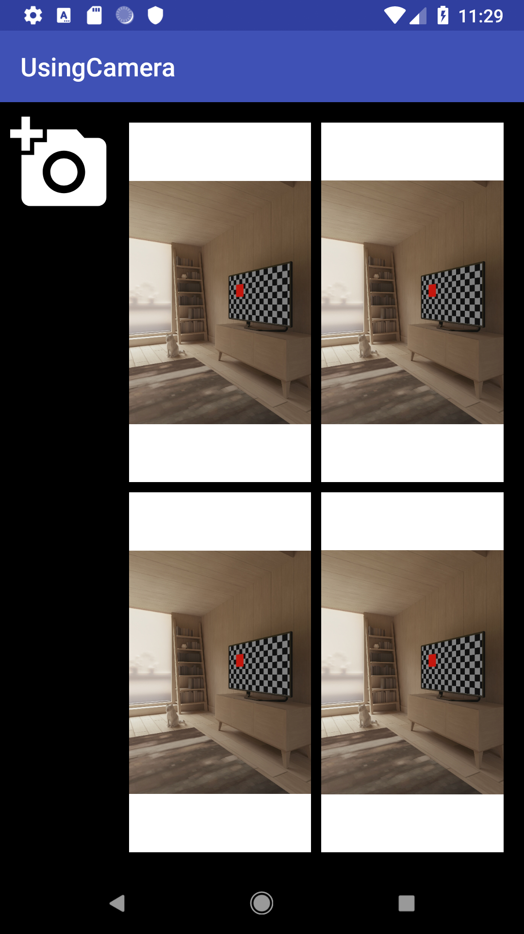
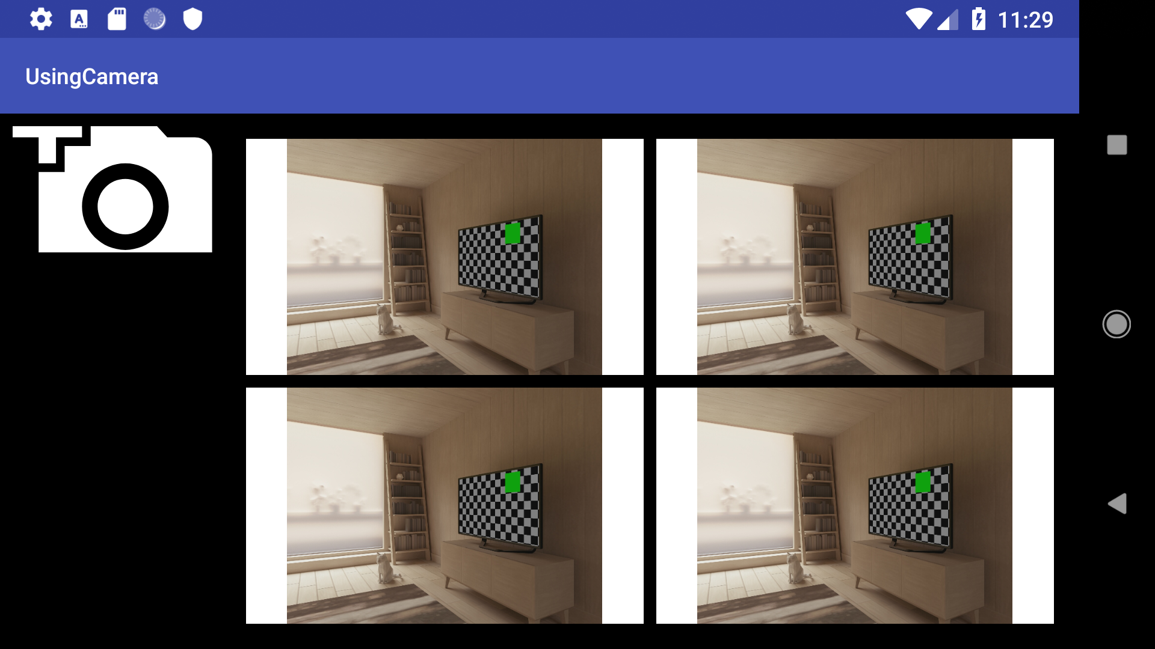
Practical – Photo Mosaic Emulator Example

Slide 16
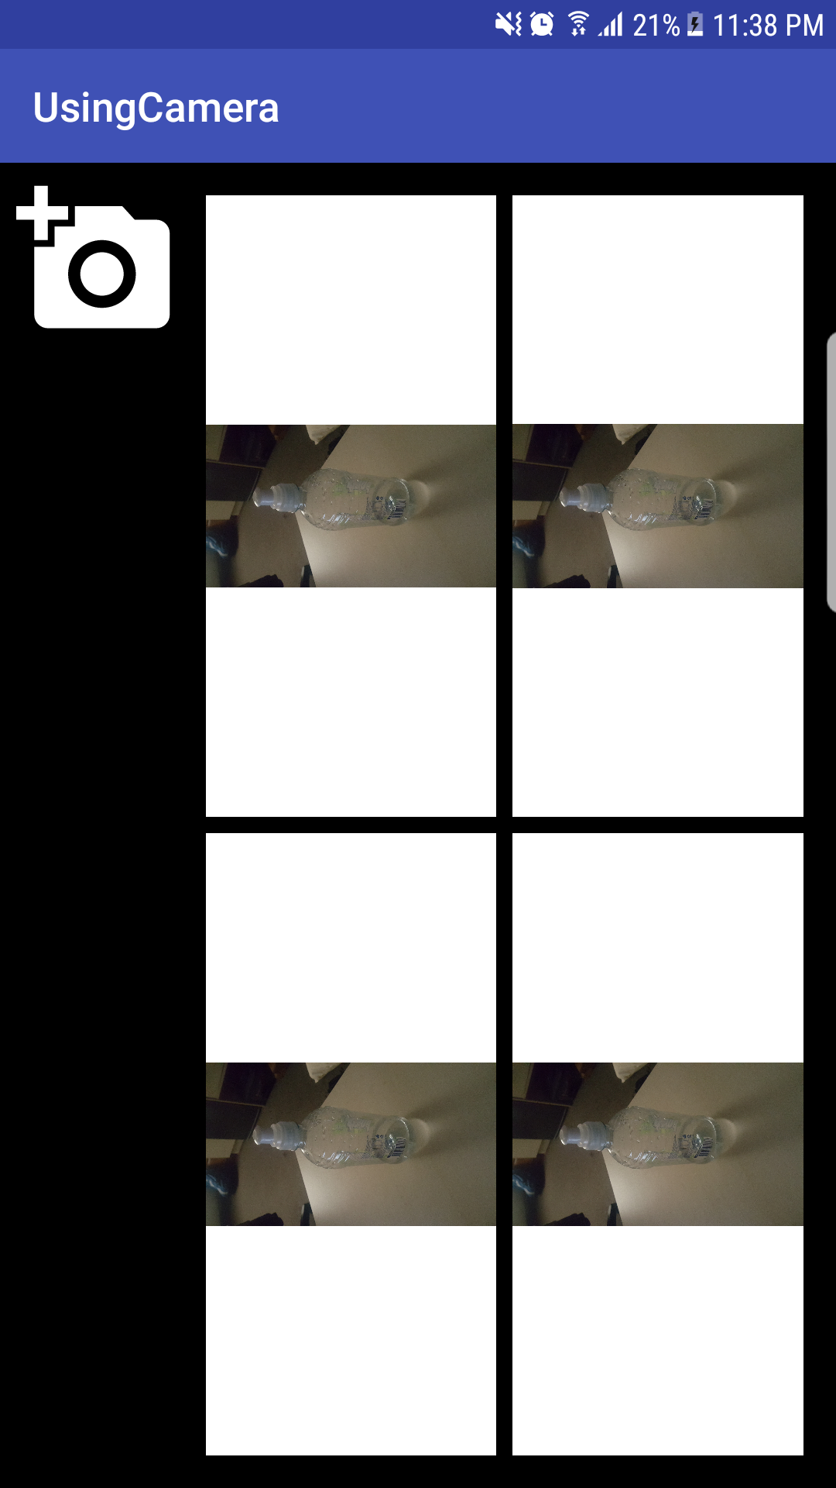
Practical – Photo Mosaic Phone Example

Slide 17
Technical note
If your images are too large, Android will not load them correctly into your ImageViews
No error is thrown
Reduce the fetched bitmap (using the appropriate static method of the Bitmap class) before assignment to the ImageView

Slide 18
3rd party services
Self-study lab
Handout with be provided in the drive

